Slide 1

System Walkthrough
Contract Monthly Claim System Overview

Slide 2

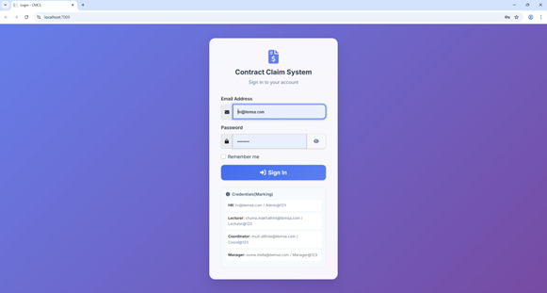
Login Interface
Secure Authentication: Authenticates users securely to ensure authorized access only.
Role-Based Redirect: Automatically opens the corresponding dashboard based on the user's role (HR, Lecturer, etc.).
Feature Access: Loads all features necessary for the specific user role upon login.

Slide 3
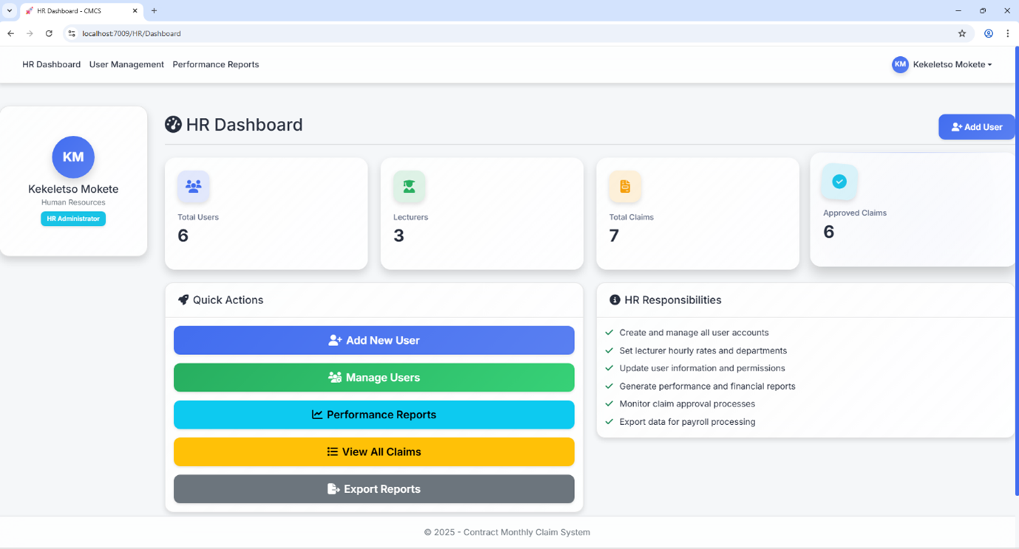
HR Dashboard Overview
Key Metrics: View total users, total lecturers, and claims submitted vs. approved.
User Operations: Actions to add or create new users and manage existing accounts.
Reporting: Access performance reports and view all claims directly from the dashboard.

Slide 4
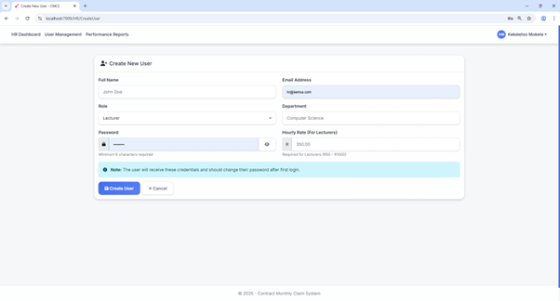
Create User Functionality
User Details: HR inserts details such as name, email, role, and department.
Security: Sets up the initial password for user login.
Rate Configuration: Allows setting the specific hourly rate for lecturers during creation.

Slide 5
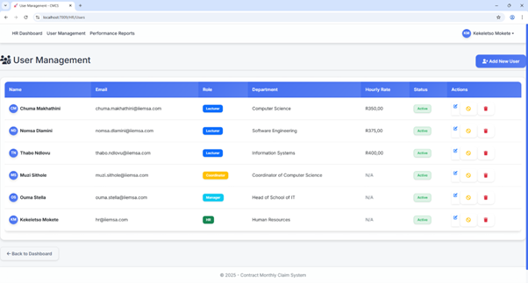
User Management
Overview: Displays a comprehensive list of all registered users.
Administration: Provides options to edit user details or temporarily deactivate accounts to prevent login.
Deletion: Allows permanent deletion of user records if necessary.

Slide 6
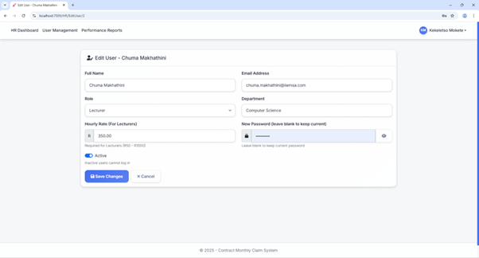
Edit User Details
Data Modification: Interface for updating existing user information.
Flexibility: Allows HR to correct errors or update roles and departments as needed.
Maintenance: Ensures user records remain accurate and up-to-date.

Slide 7
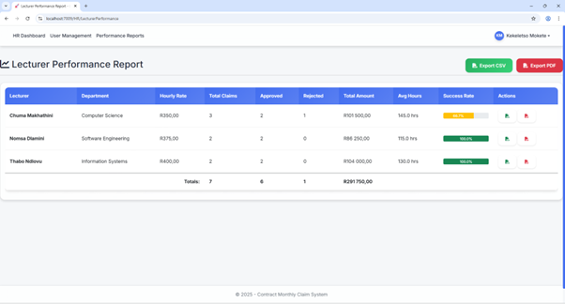
Lecturer Performance Report
Claim Analysis: Shows all lecturers who have made claims and their details.
Export Options: Reports can be exported as both CSV and PDF files for external analysis.
Individual Reports: HR can also generate and export individual lecturer reports.

Slide 8
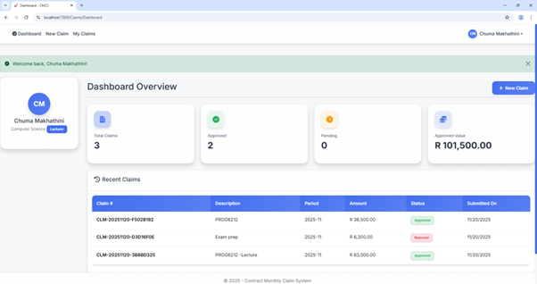
Lecturer Dashboard
Personalized View: Displays the specific lecturer's claim history.
Status Tracking: Allows lecturers to see the status of their submitted claims at a glance.
Quick Access: Provides direct navigation to submit new claims.

Slide 9
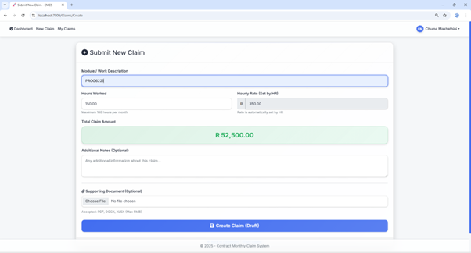
Submit Claim
Rate Control: Hourly rate is pre-set by HR and cannot be modified by the lecturer.
Constraints: Hours worked are limited to a maximum of 180 hours.
Automation: Includes auto-calculation of total claim amount based on hours and rate.
Documentation: Supporting document upload is optional but available.

Slide 10
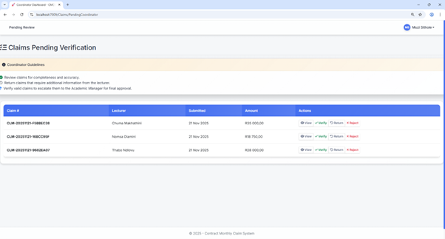
Coordinator Dashboard
Workflow Management: Displays all claims submitted by lecturers pending verification.
Actionable Items: Options to view claim details or verify claims to move them to the manager.
Review Process: Capability to return claims for corrections or reject them outright.

Slide 11
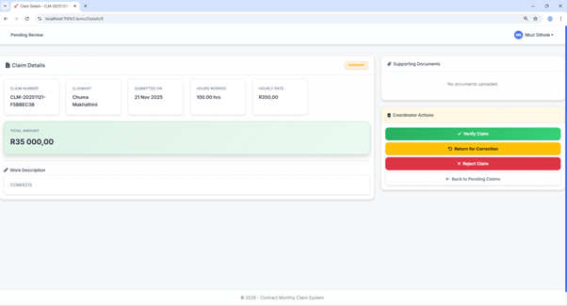
Claim Details (Coordinator)
Comprehensive View: Shows all details of a specific claim and its current status.
Enhanced Actions: Action buttons (Verify, Return, Reject) were added to improve functionality based on feedback.
Verification: Ensures data accuracy before manager approval.

Slide 12
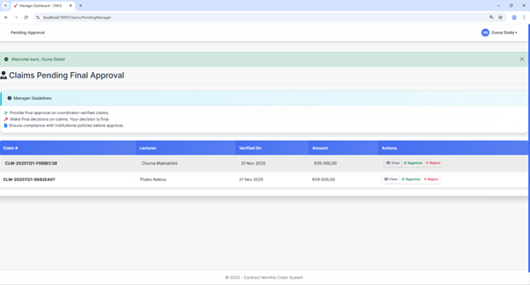
Manager Dashboard
Final Approval: Showcases all claims verified by the coordinator awaiting final approval.
Oversight: Managers can view claim details to ensure compliance.
Decisions: Provides controls to Approve or Reject the verified claims.

Slide 13
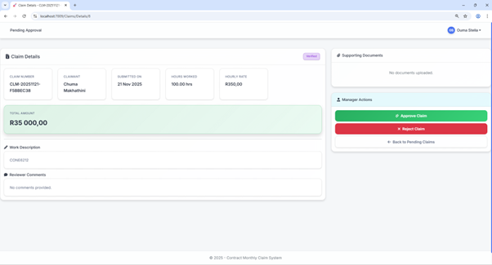
Claim Details (Manager)
Status Update: Displays claim details with status changed to "Verified" by Coordinator.
Final Action: Contains the final Approve and Reject buttons.
Transparency: Ensures the manager has all context before making a financial decision.

Slide 14

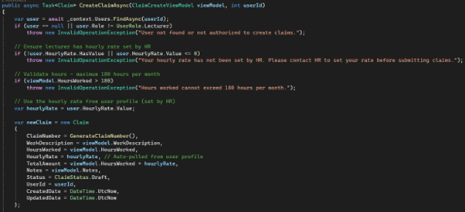
Backend Logic: CreateClaimAsync
This backend method ensures strict data integrity during claim creation.
It validates all input, checks against the 180-hour limit, and accurately persists the claim details to the database.
It is the core logic engine for the "Submit Claim" feature.

Slide 15


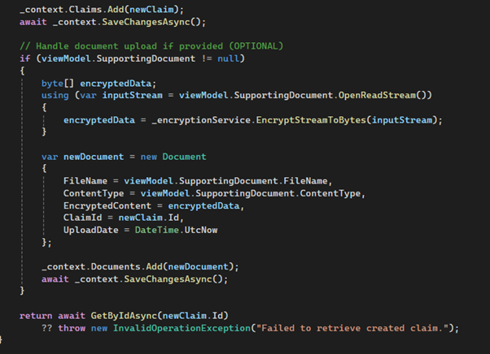

Utilities: Documents & Session
File Upload Logic Handles optional supporting document uploads during claim creation.
SetCurrentUser Method Stores the logged-in user's ID in the session to maintain state.

Slide 16
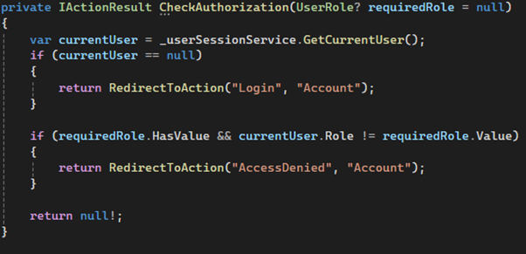
Security: CheckAuthorization
Authentication: Verifies if the user is currently registered in the system.
Access Control: Ensures that users are logged in before they can access restricted areas.
Gatekeeper: Acts as the primary method for protecting route access.

Slide 17
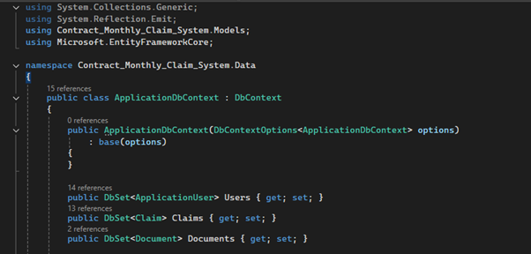
Data Access: ApplicationDbContext
Entity Framework: The primary class for communicating with the database.
Data Retrieval: Manages fetching, updating, and saving data across the application.
Synchronization: Ensures that the application state corresponds perfectly with the database records.

Slide 18
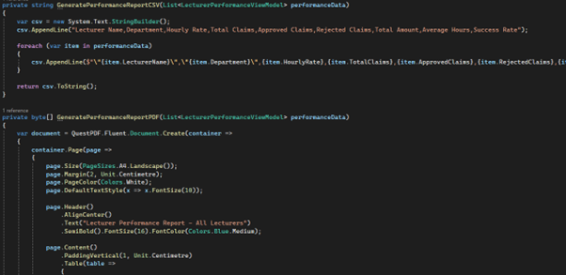
Reporting Logic
HR Controller Methods: GeneratePerformanceReportCSV and GeneratePerformanceReportPDF.
Data Processing: Retrieves performance data and formats it for export.
Downloadable Output: Generates files that can be downloaded directly by the HR user.

Slide 19




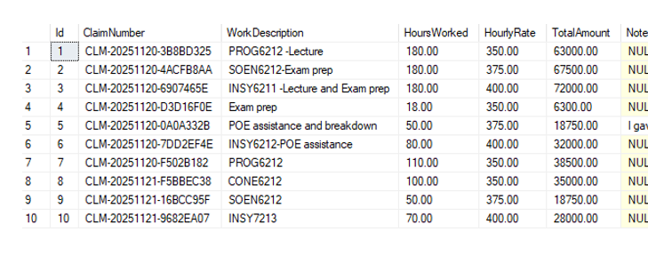
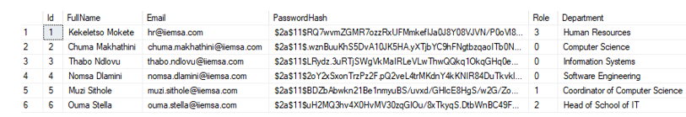
Database Tables
Claims Table Stores all claim records and status details.
Documents Table Stores file paths for uploaded documents.
Users Table Stores user profiles, roles, and credentials.

